Slide 1
NORTH WEST HOUSING CORPORATION
Presenting
MADIBENG/ LANSERIA
MEGA CITY
DEVELOPMENT
August 2023

Slide 2
EXECUTIVE SUMMARY
The Pelindaba / Necsa site is the identified area for Madibeng/ Lanseria Mega City. The Hartbeespoort location was designed and thought through after discussions with Necsa.
The North West Housing Corporation and various Local Authorities to further put together a feasible and integrated development that accommodates all the requirements as set out to improve and enhance the Local Socio Economics, Social Amenities, Health Care Facilities, Job Creation opportunities and overall better living standards and adequate accommodation.

Slide 3
VISION:
To achieve the above and the following outcomes through implementation of its National Priority Projects:
To promote the creation of integrated human settlements,
Promote spatial transformation and consolidation,
Promote social diversity for different income groups by mixed types and tenure within the same settlements,
Deliver housing at scale and various typologies to cater for different housing markets,
Bring together the technical capabilities to undertake the long-term planning, to elevate the position of urban policies and provide greater traction across government and stakeholders,
Introduce innovation to complete work within time and budget,
To enhance collaboration and partnership between government and the creation of human settlements.

Slide 4
PROJECT OVERVIEW & BACKGROUND
The North-West Housing Corporation together with the Dept. Human Settlements identified the need for a minimum of 30 000 residential units to be built in the medium to long term in the North-west Province.
The concept “Mega City” is identified as one of the tools to address this need of which Remainder of Portion 2 of the farm HARTBEESPOORT No. 400 – J.Q in the HARTBEESPOORT area is one of them.

Slide 5
LOCALITY
It is important to note that future development of Hartbeespoort area in this case will be done in a southern direction and that of Lanseria in a western direction, aligned with the N4. This is to curb further urban and to ensure that the two developments link with one another in the near future to ensure optimal usage of engineering infra-structure, etc.
The area identified lies between Lanseria & Brits/ Madibeng and Hartbeespoort at almost the centre of the proposed Mega City
The area has various slopes and ridges, with a flat plato to the north.
The R104 splits the city with the R511 running into a section towards the North East side.
The R512 / Malibongwe or Pelindaba Road enters the West wing of the city, coming from Lanseria towards Hartbeespoort.
Very good access roads towards the proposed city from all areas.
The river is from the west running behind the south towards the North West.
This area is perfect for greenfield development to the north of Pelindaba and Hartbeespoort.

Slide 6
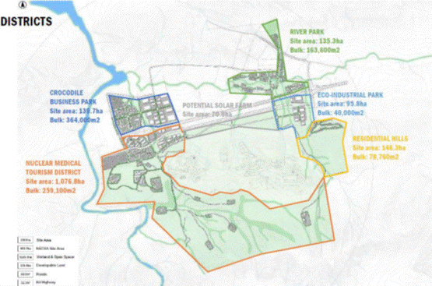
DEVELOPMENT OVERVIEW LAYOUT

Slide 7
4. PROPOSED DEVELOPMENT:
Property description: Remainder of Portion 2 of the farm HARTBEESPOORT No. 400 – J.Q.
Total area: Approximately 1315ha in extent
Development Type: A Mixed-Use Integrated Development that provides affordable living through the housing sector
(BNG’s, Flisp, Gap, Low Income Rentals, affordable housing, etc)
The current proposal features a medium to long terms development structure, whereas within the requirement there will be 2 major phases set out: (Total no of units 13 257)
  1st phase 2-6 years (7757 units)
  2nd future phase 7-12 years (5500 units)

Slide 8
6. Densification & Erf Sizes
 | Area | Zoning | Number of Erven / Density | Erf size / Number units | Proposed FSR
Portions 1 | ± 153ha | Residential 2 | 5508 units | 35-45u /ha | 35-60m2 units
Portions 2 | ± 45ha | Residential 1 | 1285 stands | 350m2 | +- 350m2 stands
Portions 2 -phase 2 | ±101ha | Residential 3 | 6464 units | 80u/ha | 40 – 50m2
Portions 3 | ± 139ha | Business |  | 973 000m2 | 0.80%
Portion 4 | ± 95.8ha | Industrial |  | 670 000m2 | 0.70%
Portion 5 & 6 | ± 1000ha | Mixed zoning Tourism, education, agriculture |  | 40 structures | Educational structure Tourism structures Farming

Slide 9
6. PROJECT & FINANCIAL INDICATORS
Project & Financial indicators | Phase 1 - 6 years |  | Phaze 2 | 7-12 years
Residential 1 Stands - Serviced stands | 1 285 |  | 0
Residential 2 - Medium density | 3 008 |  | 2 500
Residential 3 - High density walk ups | 3 464 |  | 3 000
Total no of units per phase | 7 757 |  | 5 500
Total no of units All Phases | 13 257
Commercial & Business - m2 | 1 630 000,00
Land Size - 3 portions combined | 1300ha
Type of Development | Mixed Integrated
Social Amenities | 8 |  | 6
External Bulk Infrastructure & Contributions | R 1 264 139 388,06 |  | R | 66 533 652,00
Internal Reticulation | R 1 719 432 900,00 |  | R | 262 488 600,00
Electrical Infrastructure & Contributions | R 100 830 584,34 |  | R | 7 589 398,82
Land Costs / Purchase Price | R 195 000 000,00 |  | R | -
Split per phase | 58,5% |  | 41,5%
Professional Fees Land Development | R 26 373 564,95 |  | R | -
Total Top Structure Development | R 1 915 613 792,00 |  | R | 1 415 810 000,00
Professional Fees Top Structures | R 99 037 233,05 |  | R | 73 197 377,00
Total Estimated Development Cost | R7 146 046 490,22
Total Cost per phase | R 4 181 329 307,13 |  | R | 2 964 717 183,09
Split % | 58,5% |  | 41,5%

Slide 10

Thank You!

